Slide 1
Smart Mathematics Tutor Using IBM Watson

Slide 2
TEAM : IT_AIML_A08
CHANDANA 18481A1204
DIVYA 18481A1251
SAMPATH 18481A1229
SANDEEP 19485A1203

Slide 3
Introduction
Smart Maths tutor system is a web based graphical user interface where a user gets to draw shapes of mathematical figures such as square, triangle, circle etc. for which the output would be related formulas to the drawn figure.

Slide 4
Project Objectives
know fundamental concepts and techniques of Convolutional Neural Network along with GUI creation and basic of opencv.
gain a broad understanding of image data.
Know how to pre-process the data as per the requirements.
know how to build a web application using Flask framework

Slide 5
Prerequisites
Anaconda navigator
Python packages
Deep Learning Concepts
CNN
Opencv
Flask
Tkinter

Slide 6
Image Preprocessing
we will be improving the image data. some image features important for further processing, although perform some geometric transformations of images like rotation, scaling, translation etc

Slide 7
Import The ImageDataGenerator Library
Image data augmentation is a technique that can be used to artificially expand the size of a training dataset by creating modified versions of images in the dataset.
The Keras deep learning neural network library provides the capability to fit models using image data augmentation via the ImageDataGenerator class.
Let us import the ImageDataGenerator class from keras

Slide 8
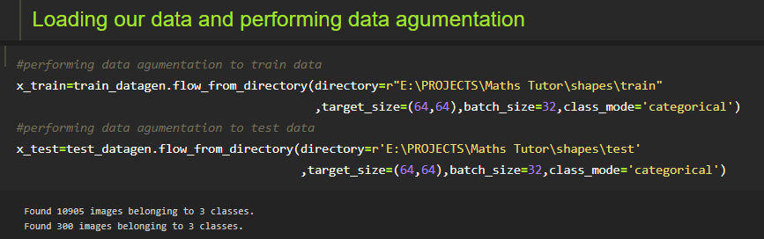
Apply ImageDataGenerator Functionality To Trainset And Testset
This function will return batches of images from the subdirectories 0,1,2 together with labels 0 to 2 {'circle': 0, 'square': 1, 'triangle': 2}

Slide 9
Model Building

Slide 10
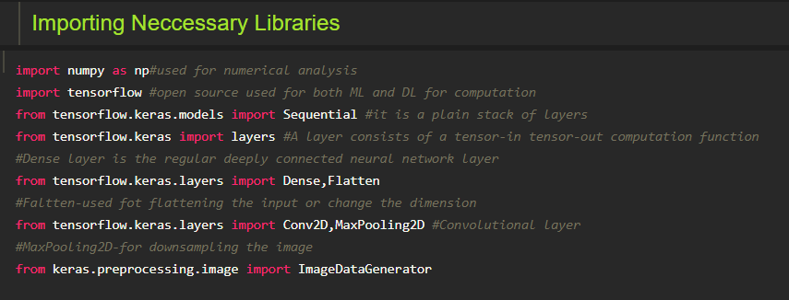
Importing The Model Building Libraries

Slide 11
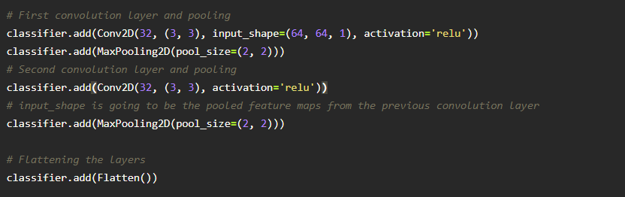
Adding CNN Layers
We are adding a convolution layer with activation function as “relu” and
with a small filter size (3,3) and number of filters (32) followed by a max pooling layer.
Maxpool layer is used to downsample the input.
Flatten layer flattens the input. Does not affect the batch size.

Slide 12
Adding Dense Layers
Dense layer is deeply connected neural network layer. It is most common and frequently used layer.

Slide 13
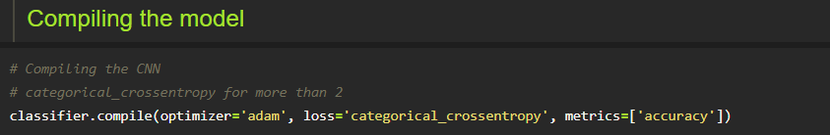
Configure The Learning Process
The compilation is the final step in creating a model. Once the compilation is done, we can move on to training phase.
Here we are using adam optimizer.

Slide 14
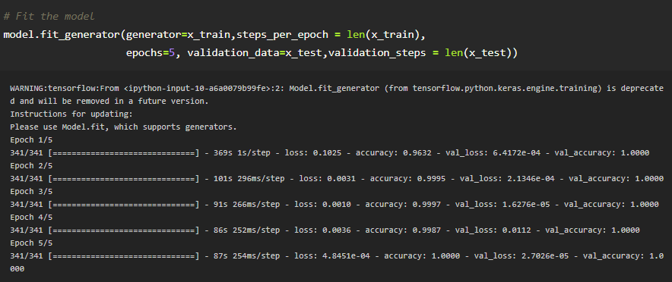
Train The Model
Train our model with our image dataset.

Slide 15
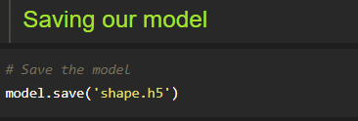
Save The Model
The model is saved with .h5 extension.
An H5 file is a data file saved in the Hierarchical Data Format (HDF). It contains multidimensional arrays of scientific data

Slide 16
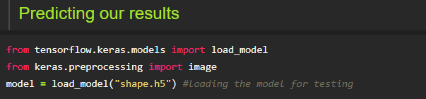
Test The Model
Evaluation is a process to check whether the model is best fit for the given problem and corresponding data.
Load the saved model using load_model

Slide 17
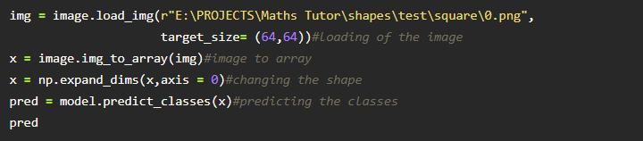
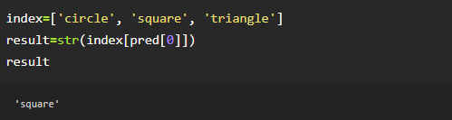
Taking an image as input and checking the results
By using the model we are predicting the output for the given input image

Slide 18
Application Building

Slide 19
Create HTML Pages
we created 2 html pages- home.html, intro.html
home.html displays home page.
intro.html displays all the details about our project.
We also use JavaScript-main.js and CSS-main.css to enhance our functionality and view of HTML pages.

Slide 20
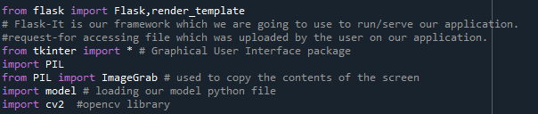
Build Python Code
Build flask file ‘app.py’ which is a web framework written in python.
App starts running when “__name__” constructor is called in main.

Slide 21
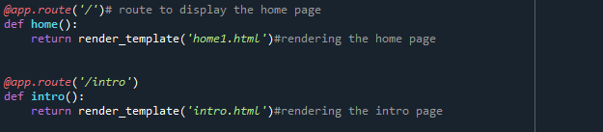
Create flask application
Routing to html pages
Render the two html pages

Slide 22
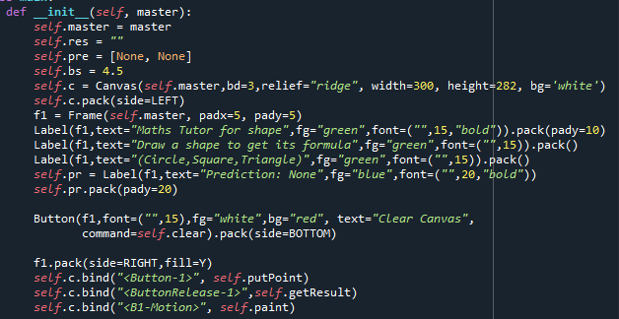
Creating a GUI

Slide 23
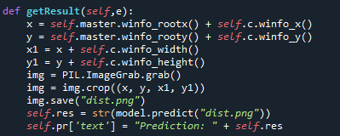
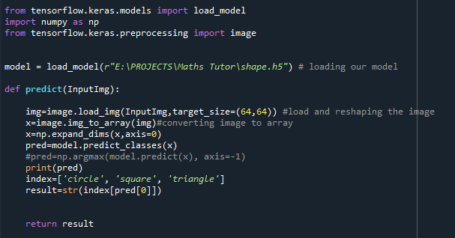
Grabbing the image and sending it to our model for prediction

Slide 24
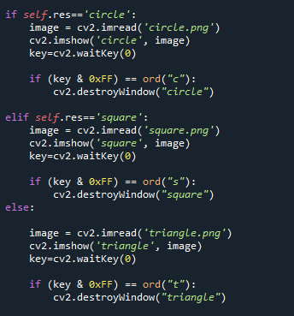
Showcase the results with the help of opencv

Slide 25

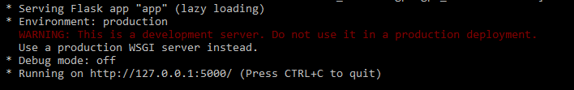
Run The Application
Open anaconda prompt
Navigate to the folder where your python script is.
Navigate to the localhost where you can view your web page.

Slide 26
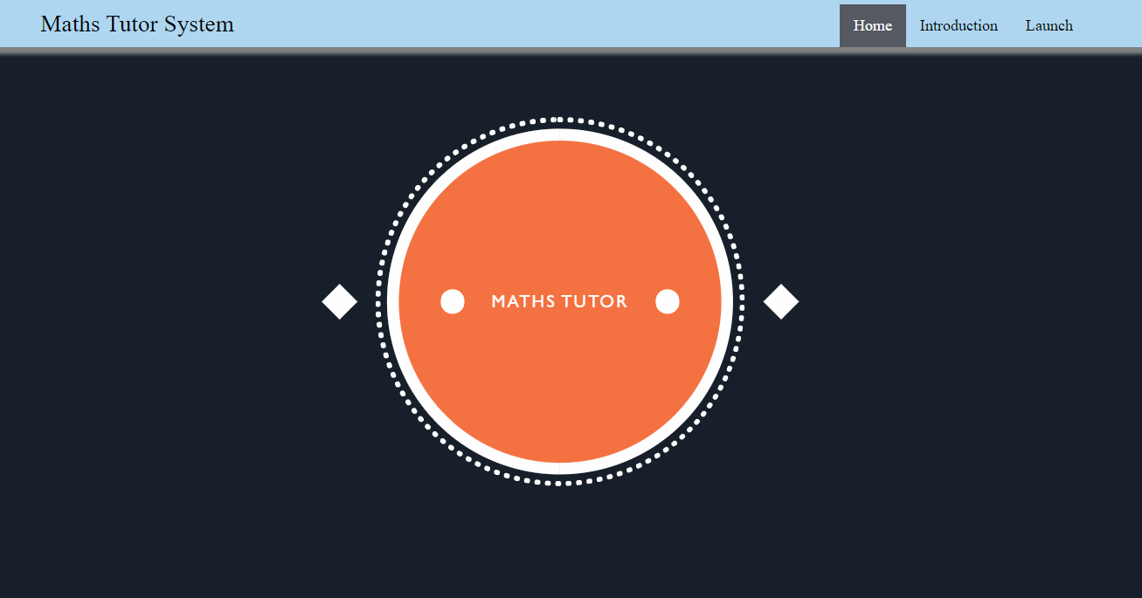
Home page

Slide 27
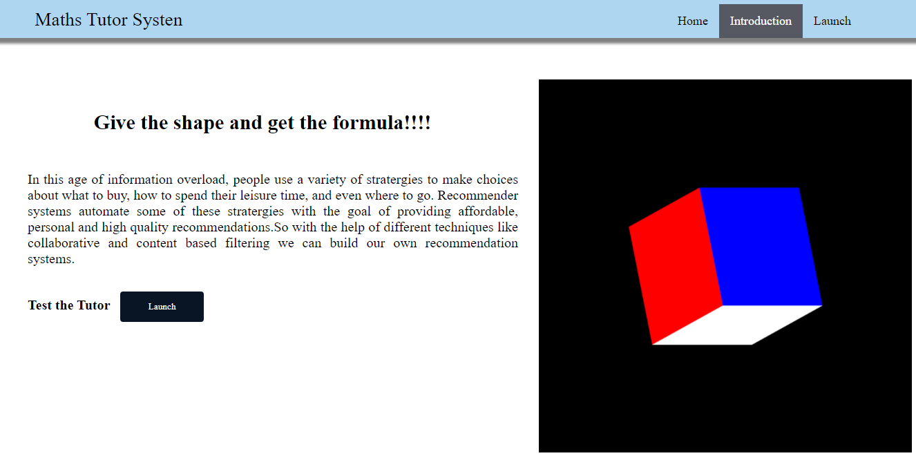
Introduction Page

Slide 28
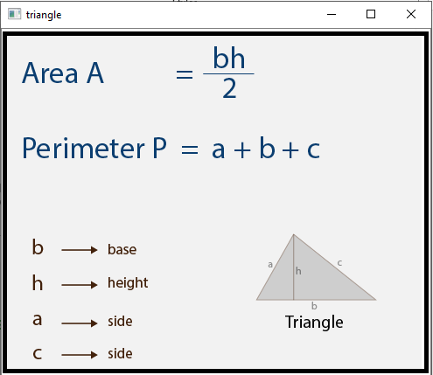
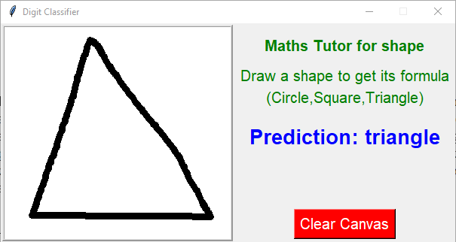
Launch Page
when you click on Launch button.
A GUI will be popped up.
Draw the shapes which we trained.
It will give you the formula according to the prediction.

Slide 29
THANK YOU

